Slide 1
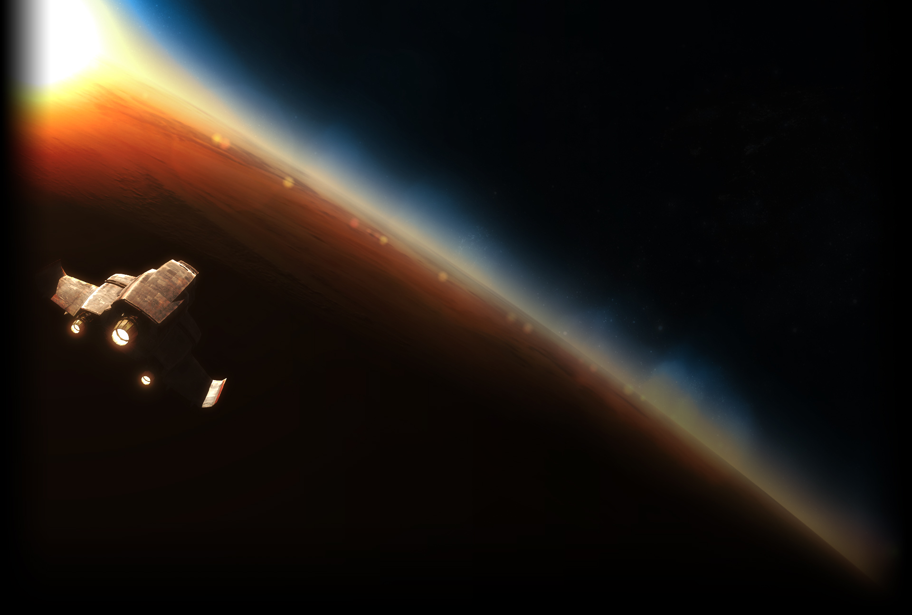
Spaceman
By John Rugen

Slide 2
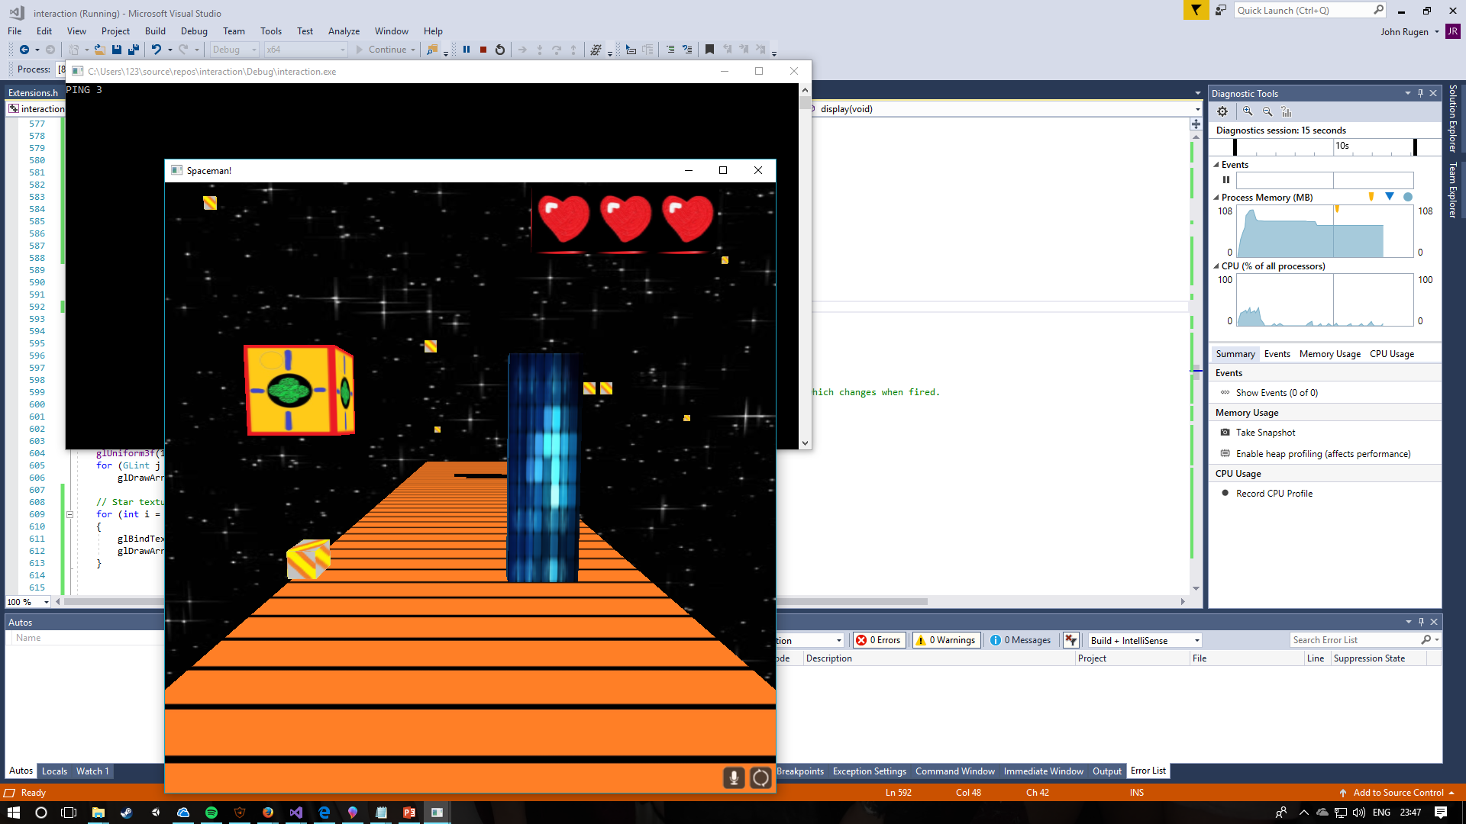
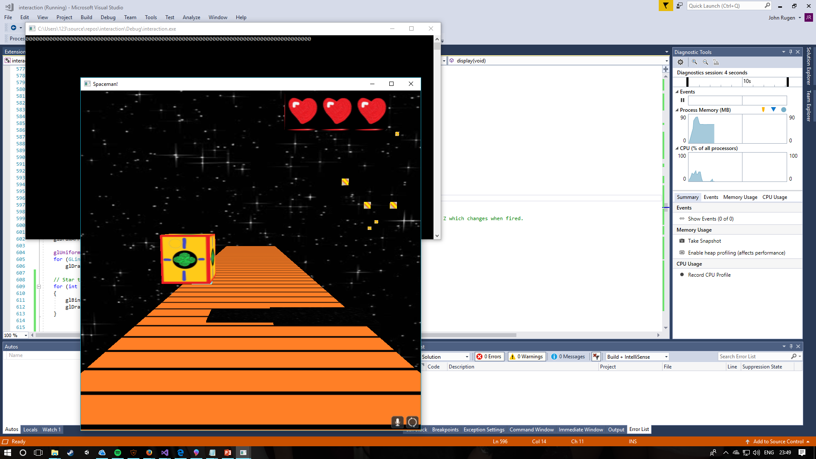
Aim of the game
You were stationed upon a mining ship and volunteered to venture down upon an enemy blockade above a mineral rich planet. You must do this with the new mining shuttle, the MX-50.
You must avoid obstacles, either shooting them down or activating boosters to clear them.
It is vital to avoid the holes in the floor, whilst the MX-50 can take a few hits, it can’t handle free falling into the planets atmosphere.

Slide 3
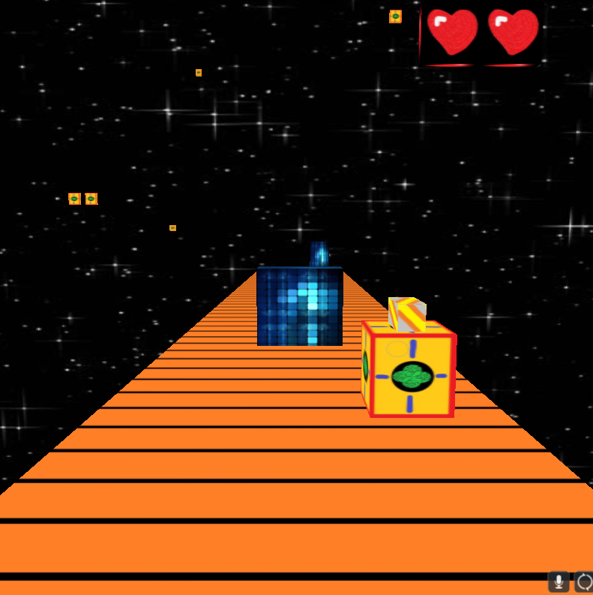
Game elements explained
How many chances you get to bump into obstacles.
Friendly mining ships flying past, you’re not alone.
Your ship & rocket, both essential your survival.
The floor you were able to land on, don’t fall off.

Slide 4
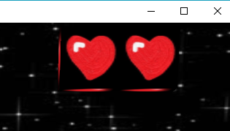

Controls
User Interface
A
D
Fire
At the top right of the screen the user is reminded how many lives they have left. Unlike cats, a player starts with only two lives and has the potential to have a maximum of three through the powerups.
SPACE

Slide 5
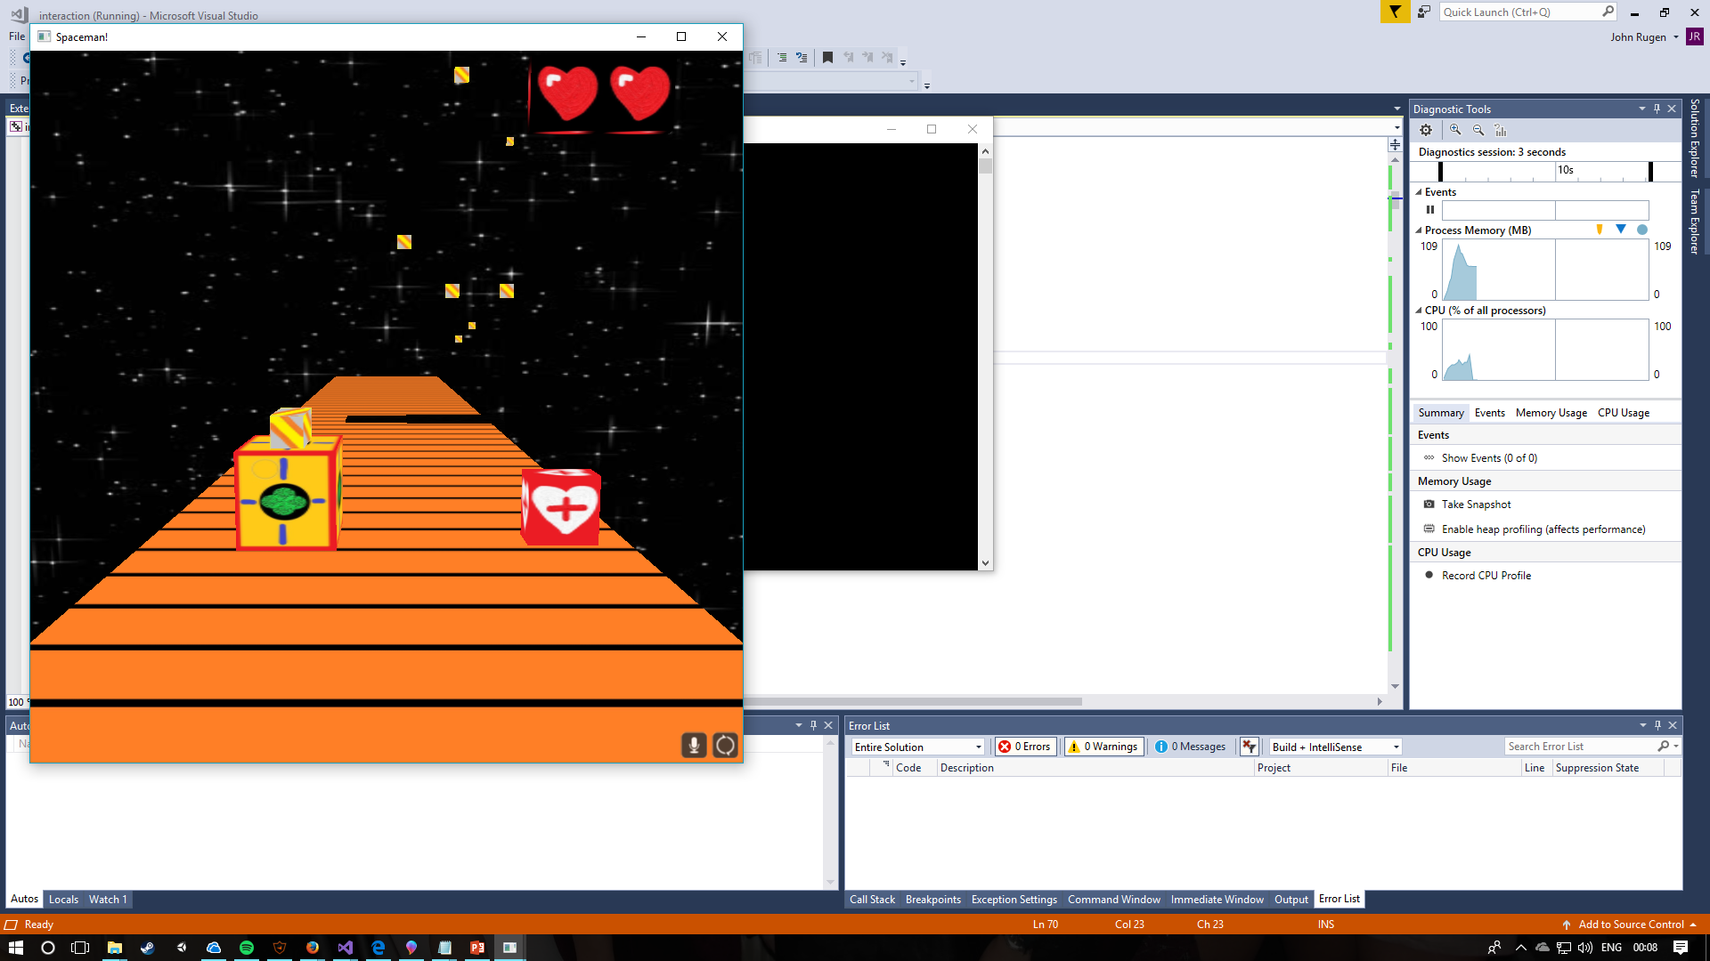
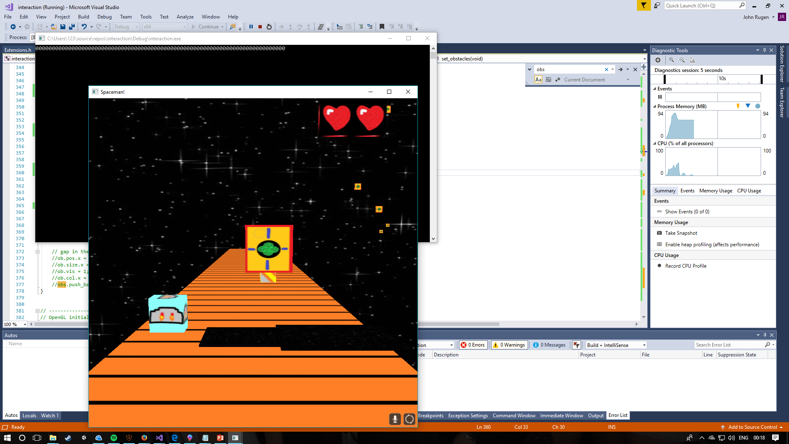
Powerups and their limitations
Life crates enable you to grab another chance, however your ship is only capable of using three at once. You can never exceed three lives.
These jetpack crates allow for you to take flight above obstacles. However, with every shot you take your jetpack becomes more likely to break.

Slide 6
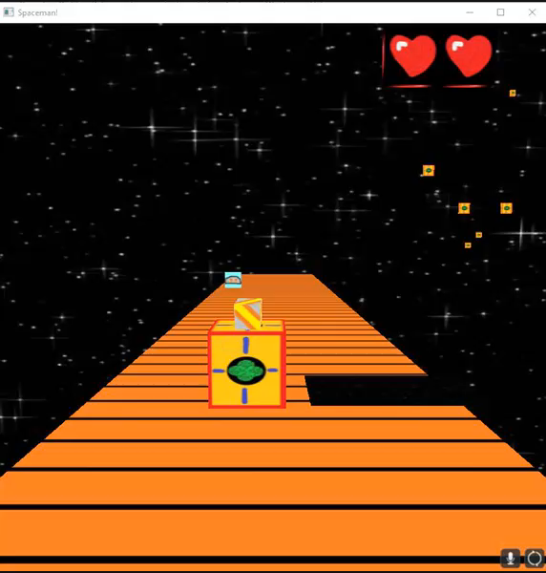
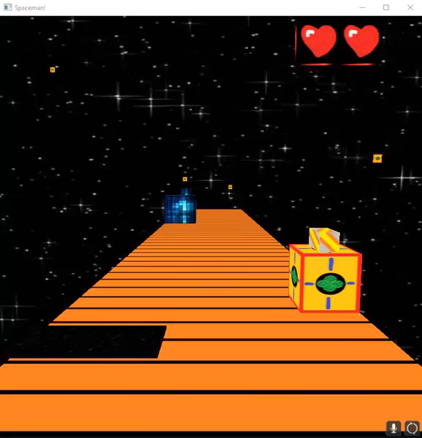
Game difficulty
The game starts off pretty easy, however with every obstacle cleared, the game speeds up. This means more obstacles coming faster and holes appearing more often. Here’s a demonstration of early game and late game.

Slide 7
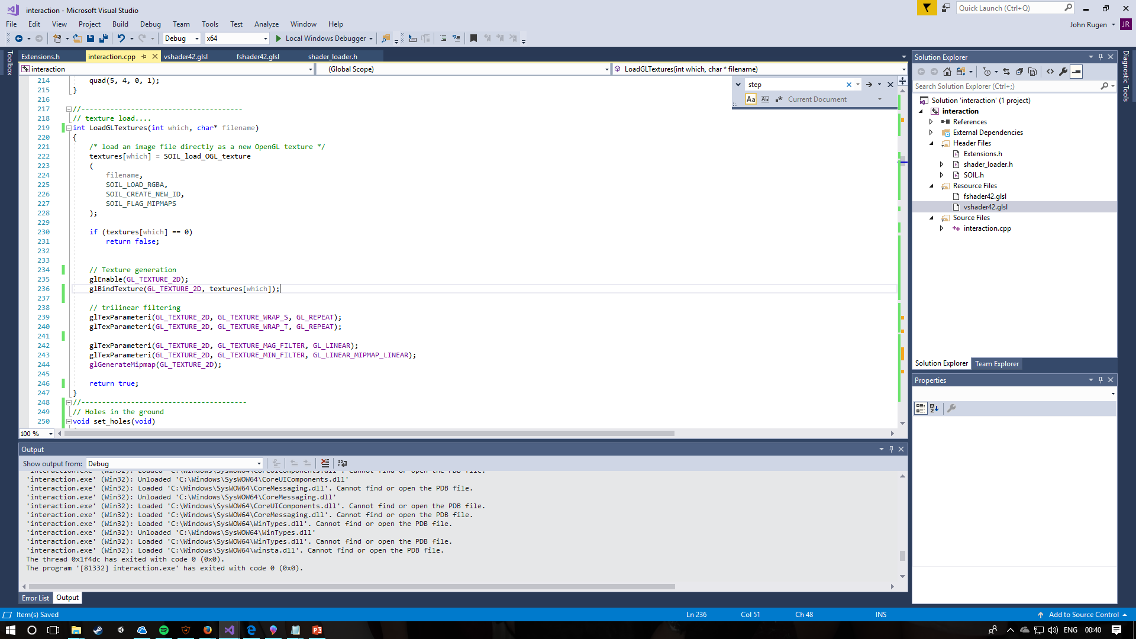
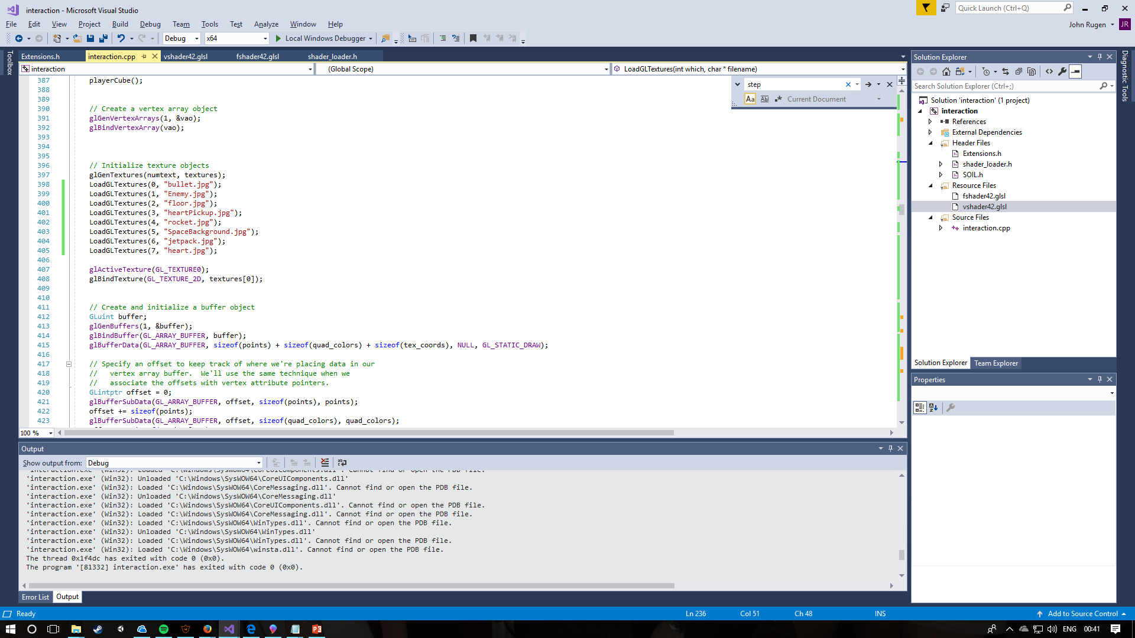
textures
Everything in the game makes use of textures rather than solid colours. These are loaded through the SOIL library.
There is a total of 8 textures being used throughout the game. All except the Enemy & space background are original textures.

Slide 8
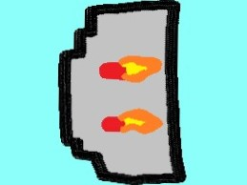


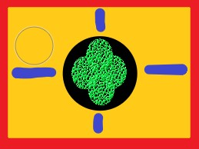
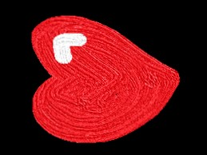

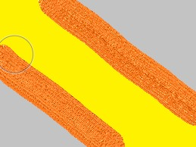

Textures

Slide 9
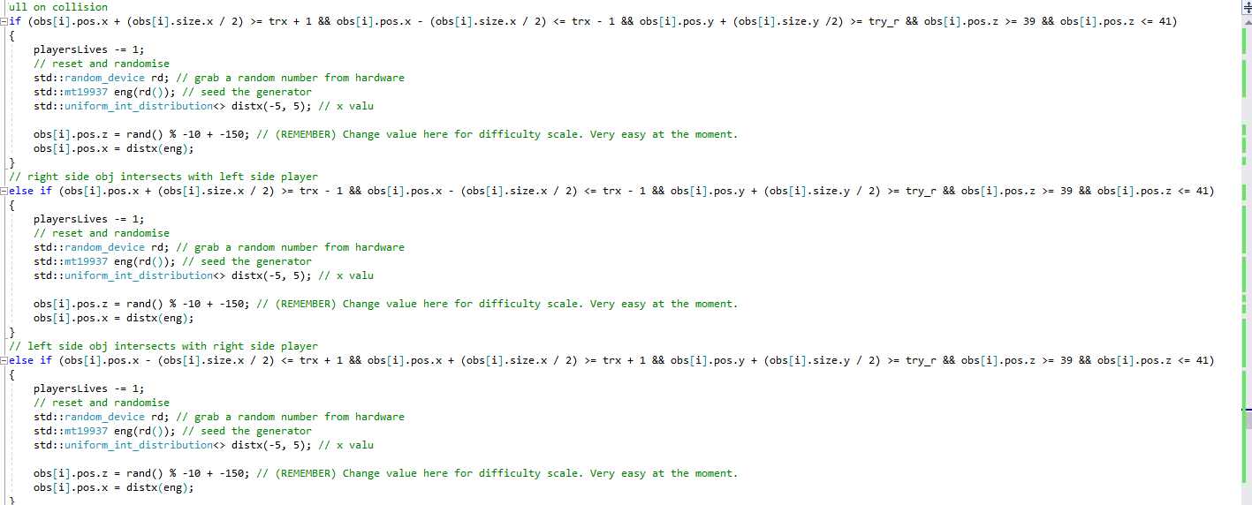
Collision
This game features working collision detection, which allows for the player to lose lives or the player to take out structures with their rocket.
This works by looping through all instances of certain obstacles, and checking if their X,Y,Z points match up with the players, various offsets and their size need to be taken into account.
Notes:
Add:
This is done with the holes in the ground, and for bullet detection.

Slide 10
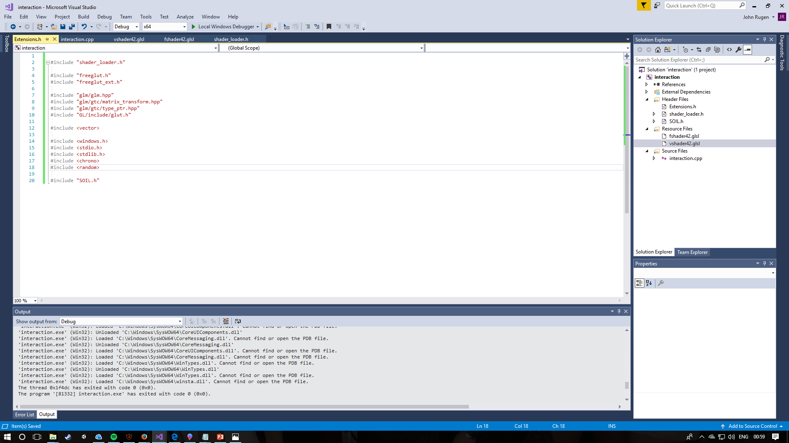
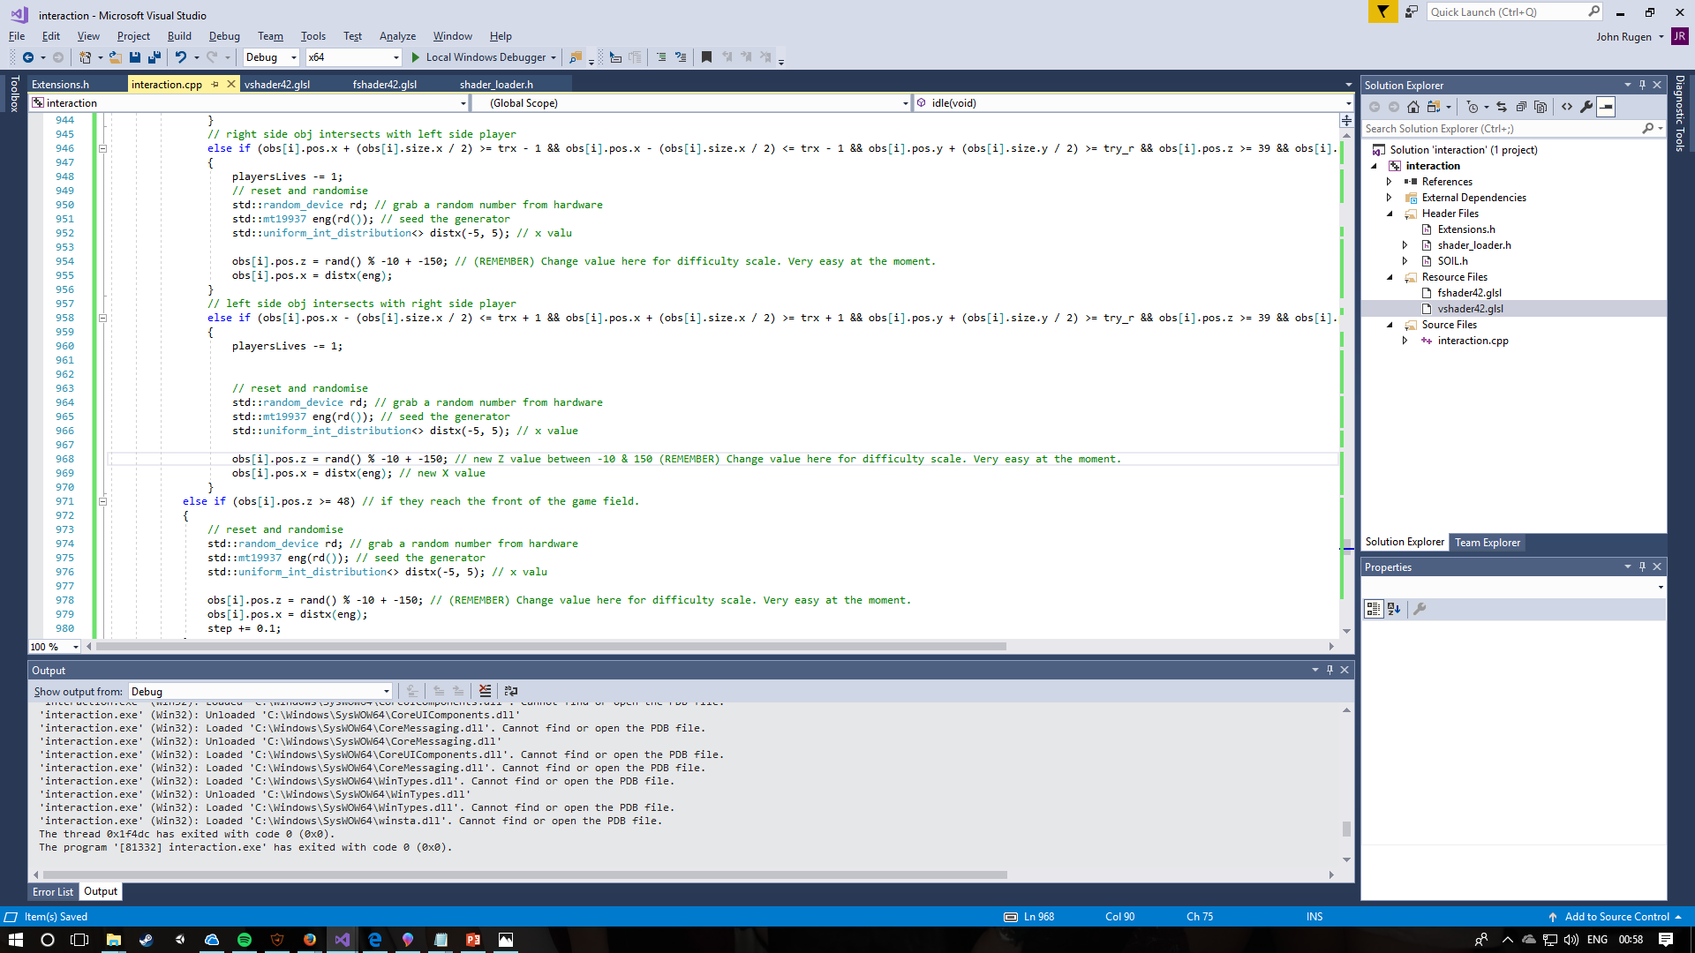
obstacles
In total, there are 14 unique obstacles placed within the game. Each obstacle once destroyed is reset with random variables to give the player a challenge rather than learning the pattern of the game.
This has been achieved by using the random header and generating a random number from the users hardware at a specific time so it’s different every time. It is then converted to a number suitable for the context it’s going to be used within.
This has been done with the ships in the background too, to create some depth to the background.

Slide 11
Future aims
Whilst the project deadline is soon, I’ll aim to continue with the project for development of my skills.
Allowing PNG files to make use of the transparency, allowing for better textures and aesthetics.
Creating a splash screen with a difficulty selection menu.
Redesign textures.
Create some sort of boss fight.
Add power ups that allow for different weapons.
Allow for the obstacles to move towards the player.

